Slide 1
Unit-VI
Computational Complexity and
Parallel Algorithms

Slide 2
Parallel Algorithms

Slide 3
What is an Algorithm?
An algorithm is a sequence of instructions followed to solve a problem. While designing an algorithm, we should consider the architecture of computer on which the algorithm will be executed. As per the architecture, there are two types of computers −
Sequential Computer
Parallel Computer
Depending on the architecture of computers, we have two types of algorithms −
Sequential Algorithm − An algorithm in which some consecutive steps of instructions are executed in a chronological order to solve a problem.
Parallel Algorithm − The problem is divided into sub-problems and are executed in parallel to get individual outputs. Later on, these individual outputs are combined together to get the final desired output.

Slide 4
Introduction
A parallel algorithm is an algorithm that can execute several instructions simultaneously on different processing devices and then combine all the individual outputs to produce the final result.
Parallel Environment:

Slide 5
Need for parallel algorithm
For high performance computing resources
For large and complex problem
A massive amount of computation is impractical on single processor

Slide 6
Significance of parallel algorithm
The problem is divided into sub-problems and are executed them independently
Solve large and complex problem
Many resources use
Reduce time
Use interconnection

Slide 7
Limitation parallel algorithm

Slide 8
Performance Metrics for Parallel algorithms
Sequential algorithm run time
Parallel algorithms run time
The speedup parallel algorithms of is defined as the ratio of the serial runtime of the best sequential algorithm for solving a problem to the time taken by the parallel algorithm to solve the same problem on p processors.
The performance of a parallel algorithm is determined by calculating its speedup.

Slide 9
Amdahl's Law
In parallel computing, Amdahl's law is mainly used to predict the theoretical maximum speedup for program processing using multiple processors. This term is also known as Amdahl’s argument.

Slide 10
Parallel Algorithm - Models
Fixed connection model
Shared connection model

Slide 11
Fixed connection model
Represent by Graph
Types:
1.Bus/linear array model
2.Ring model
3.Mesh
4.Hypercubes
5.Butterfly

Slide 12
Shared connection model
Parallel Random Access Machines (PRAM) is a model, which is considered for most of the parallel algorithms. Here, multiple processors are attached to a single block of memory.
A PRAM model contains −
A set of similar type of processors.
All the processors share a common memory unit. Processors can communicate among themselves through the shared memory only.
A memory access unit (MAU) connects the processors with the single shared memory.

Slide 13
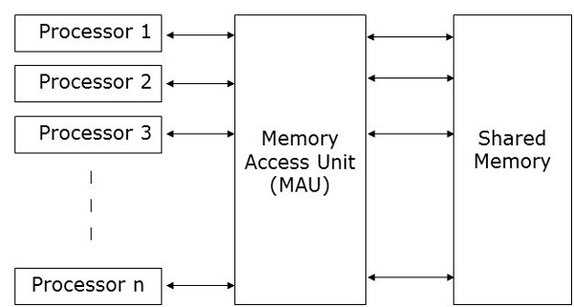

Slide 14
Here, n number of processors can perform independent operations on n number of data in a particular unit of time. This may result in simultaneous access of same memory location by different processors.
To solve this problem, the following constraints have been enforced on PRAM model −
Exclusive Read Exclusive Write (EREW) − Here no two processors are allowed to read from or write to the same memory location at the same time.
Exclusive Read Concurrent Write (ERCW) − Here no two processors are allowed to read from the same memory location at the same time, but are allowed to write to the same memory location at the same time.
Concurrent Read Exclusive Write (CREW) − Here all the processors are allowed to read from the same memory location at the same time, but are not allowed to write to the same memory location at the same time.
Concurrent Read Concurrent Write (CRCW) − All the processors are allowed to read from or write to the same memory location at the same time.

Slide 15
Depending on the instruction stream and data stream, computers can be classified into four categories −
Single Instruction stream, Single Data stream (SISD) computers
Single Instruction stream, Multiple Data stream (SIMD) computers
Multiple Instruction stream, Single Data stream (MISD) computers
Multiple Instruction stream, Multiple Data stream (MIMD) computers

Slide 16

SISD Computers
SISD computers contain one control unit, one processing unit, and one memory unit.
In this type of computers, the processor receives a single stream of instructions from the control unit and operates on a single stream of data from the memory unit. During computation, at each step, the processor receives one instruction from the control unit and operates on a single data received from the memory unit.

Slide 17
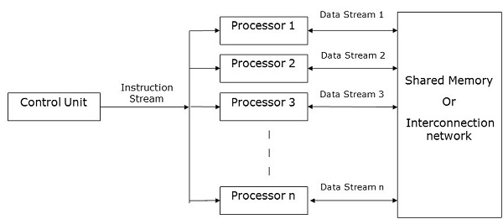
SIMD Computers
SIMD computers contain one control unit, multiple processing units, and shared memory or interconnection network.
Here, one single control unit sends instructions to all processing units. During computation, at each step, all the processors receive a single set of instructions from the control unit and operate on different set of data from the memory unit.

Slide 18
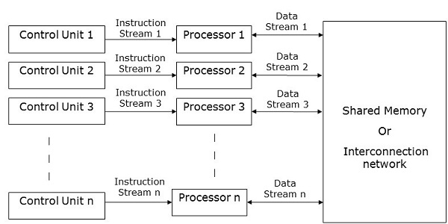
MISD Computers
As the name suggests, MISD computers contain multiple control units, multiple processing units, and one common memory unit.
Here, each processor has its own control unit and they share a common memory unit. All the processors get instructions individually from their own control unit and they operate on a single stream of data as per the instructions they have received from their respective control units. This processor operates simultaneously.

Slide 19
MIMD Computers
MIMD computers have multiple control units, multiple processing units, and a shared memory or interconnection network.
Here, each processor has its own control unit, local memory unit, and arithmetic and logic unit. They receive different sets of instructions from their respective control units and operate on different sets of data.

Slide 20
Computing with complete Binary Tree
A binary tree with n nodes is of height log n
• Can use this property in the design of parallel algorithms
• Suppose there are n data items, corresponding to the n leaf vertices of a complete binary tree
• Process them in parallel and get partial results at the non-leaf nodes • Proceed bottom up, and reach the root in log n time

Slide 21
Pointer Doubling algorithm

Slide 22
Computational Complexity

Slide 23
Computational Complexity
Computational complexity is a computer science concept that focuses on the amount of computing resources needed for particular tasks.

Slide 24
In Computer Science, many problems are solved where the objective is to maximize or minimize some values, whereas in other problems we try to find whether there is a solution or not. Hence, the problems can be categorized as follows −
Optimization Problem
Optimization problems are those for which the objective is to maximize or minimize some values. For example,
Finding the minimum number of colors needed to color a given graph.
Finding the shortest path between two vertices in a graph.
Decision Problem
There are many problems for which the answer is a Yes or a No. These types of problems are known as decision problems. For example,
Whether a given graph can be colored by only 4-colors.
Finding Hamiltonian cycle in a graph is not a decision problem, whereas
checking a graph is Hamiltonian or not is a decision problem.

Slide 25
Decidable problem
undecidable problem
Tractability
Intractability

Slide 26
1.Deterministic algorithm
In deterministic algorithm, for a given particular input,
the computer will always produce the same output
2.Non Deterministic algorithm:
deterministic algorithm, for the same input, the compiler may produce different output in different runs.

Slide 27
A polynomial-time algorithm is an algorithm whose execution time is either given by a polynomial on the size of the input, or can be bounded by such a polynomial. Problems that can be solved by a polynomial-time algorithm are called tractable problems
If we produce an output according to the given input within a specific amount of time such as within a minute, hours. This is known as Polynomial time.
Marge short, linear search, binary search
Non-Polynomial time: - If we produce an output according to the given input but there are no time constraints is known as Non-Polynomial time. But yes output will produce but time is not fixed yet.

Slide 28
Complexity classes
P-class
NP class
NP hard
NP complete

Slide 29
P class
The set of decision-based problems come into the division of P Problems who can be solved or produced an output within polynomial time by deterministic algorithm.
P problems being easy to solve.
Example: Marge short, linear search, binary search

Slide 30
NP Class
Definition of NP class Problem: - The set of all decision-based problems came into the division of NP Problems who can't be solved or produced an output within polynomial time but verified in the polynomial time.
NP class contains P class as a subset.
NP problems being hard to solve.
non-deterministic polynomial.

Slide 31
NP hard
Definition of NP-hard class: - Here you to satisfy the following points to come into the division of NP-hard
If we can solve this problem in polynomial time, then we can solve all NP problems in polynomial time
If you convert the issue into one form to another form within the polynomial time
The following problems are NP-Hard
The circuit-satisfiability problem
Set Cover
Vertex Cover
Travelling Salesman Problem

Slide 32
NP-complete
Definition of NP-complete class: - A problem is in NP-complete, if
It is in NP
It is NP-hard
Determining whether a graph has a Hamiltonian cycle
Determining whether a Boolean formula is satisfiable, etc.

Slide 33
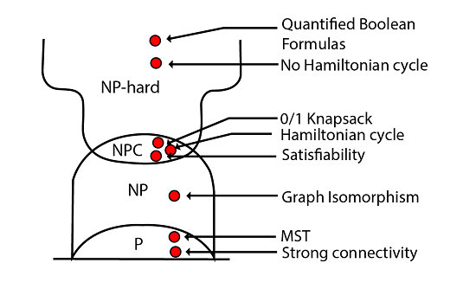

Slide 34
Satisfiability –SAT problem
A Boolean function is said to be SAT if the output for the given value of the input is true/high/1
F=X+YZ (Created a Boolean function by CIRCUIT SAT)
Varieties
CNF
3 SAT
DNF Satisfiability

Slide 35
Vertex Cover problem
Definition: - It represents a set of vertex or node in a graph G (V, E), which gives the connectivity of a complete graph
Given a graph G(V, E) and a positive integer k, the problem is to find whether there is a subset V’ of vertices of size at most k, such that every edge in the graph is connected to some vertex in V’.

Slide 36
Problem – Given a graph G(V, E) and a positive integer k, the problem is to find whether there is a subset V’ of vertices of size at most k, such that every edge in the graph is connected to some vertex in V’.
Explanation – First let us understand the notion of an instance of a problem. An instance of a problem is nothing but an input to the given problem. An instance of the Vertex Cover problem is a graph G (V, E) and a positive integer k, and the problem is to check whether a vertex cover of size at most k exists in G. Since an NP Complete problem, by definition, is a problem which is both in NP and NP hard, the proof for the statement that a problem is NP Complete consists of two parts:

Slide 37
1.Proof that vertex cover is in NP – If any problem is in NP, then, given a solution to the problem and an instance of the problem (a graph G and a positive integer k, in this case), we will be able to verify (check whether the solution given is correct or not) the solution in polynomial time.
The solution for the vertex cover problem is a subset V’ of V, which contains the vertices in the vertex cover. We can check whether the set V’ is a vertex cover of size k.

Slide 38
Clique problem
A clique is a subgraph of a graph such that all the vertices in this subgraph are connected with each other that is the subgraph is a complete graph. The Maximal Clique Problem is to find the maximum sized clique of a given graph G, that is a complete graph which is a subgraph of G and contains the maximum number of vertices.

